Slide 1

Inheritance

Slide 2
Introduction to Inheritance
This mechanism of deriving a new class from existing/old class is called “inheritance”.
The old class is known as “base” class, “super” class or “parent” class”;
and the new class is known as “sub” class, “derived” class, or “child” class.
Parent
Inherited capability
Child

Slide 3
Introduction to Inheritance
Reusability--building new components by utilising existing components- is yet another important aspect of OO features.
It is always good/“productive” if we are able to reuse something that is already exists rather than creating the same all over again.
This is achieve by creating new classes, reusing the properties of existing classes.

Slide 4
Different forms of inheritance
The different forms of inheritance are:
Single inheritance (only one super class)
Multiple inheritance (several super classes)
Hierarchical inheritance (one super class, many sub classes)
Multi-Level inheritance (derived from a derived class)
Hybrid inheritance (more than two types)

Slide 5
Forms of inheritance
B
D
B
C
A
A
B
C
A
(a) Single Inheritance
(b) Multiple Inheritance
(c)Hierarchical Inheritance
C
D
B
C
B
A
A
(d) Multi-Level Inheritance
(f) Hybrid Inheritance

Slide 6
Defining Derived Class
class derived-class-name : visibility-mode base-class-name
{………};
class derived-class: access-specifier base-class { };
Visibility mode is optional.(by default: private)
Visibility mode specifies whether the features of the base class are
privately derived or publicly derived.

Slide 7
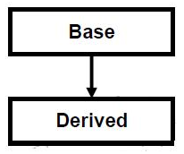
Single Inheritance
when a single derived class is created from a single base class then the inheritance is called as single inheritance.
class Base { .... ... .... };
class Derive : public Base { .... ... .... };
int main()
{ … } ;

Slide 8

Single Inheritance
#include <iostream>
using namespace std;
// Base class
class Shape
{
public:
void setWidth(int w)
{
width = w;
}
void setHeight(int h)
{
height = h;
}
protected:
int width;
int height;
};
// Derived class
class Rectangle: public Shape
{
public:
int getArea()
{
return (width * height);
}
};
int main(void)
{
Rectangle Rect;
Rect.setWidth(5);
Rect.setHeight(7);
// Print the area of the object.
cout << "Total area: " << Rect.getArea() << endl;
return 0;
}

Slide 9
Inheritance: Private, Protected and Public
Inside the class.
class alpha
{
private://optional
…………//visible inside this class only
protected://visible inside this class
…………//and its immediate derived class
public://visible to all
…………
};

Slide 10
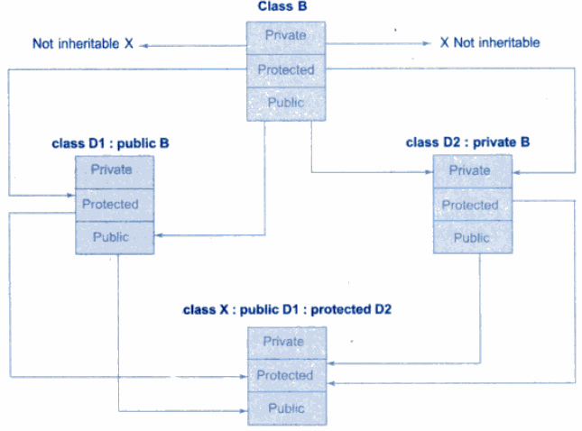
Inheritance: Private, Protected and Public Visibility mode

Slide 11
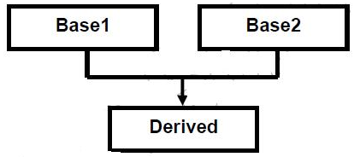
Multiple Inheritance
when a derived class is created from more than one base class then that inheritance is called as multiple inheritance.
Or
A C++ class can inherit members from more than one class and here is the extended syntax:
class derived-class: access-specifier baseA, access baseB....

Slide 12
Multiple Inheritances Example
class Shape{
public:
void setWidth(int w)
{
width = w;
}
void setHeight(int h)
{
height = h;
}
protected:
int width;
int height;
};
// Base class PaintCost
class PaintCost {
public:
int getCost(int area)
{
return area * 70;
}
};
// Derived class
class Rectangle: public Shape, public PaintCost {
public:
int getArea()
{
return (width * height);
}
};
int main(void)
{
Rectangle Rect;
int area;
Rect.setWidth(5);
Rect.setHeight(7);
area = Rect.getArea();
// Print the area of the object.
cout << Rect.getArea() << endl;
// Print the total cost of painting
cout << Rect.getCost(area) << endl;
return 0;
}

Slide 13
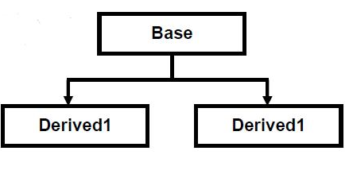
Hierarchical Inheritance
when more than one derived class are created from a single base class, then that inheritance is called as hierarchical inheritance.
class base_classname {…………….};
class derived_class1:visibility_mode base_classname {……………………};
class derived_class2:visibility_mode base_classname {………………….};

Slide 14
Hierarchical Inheritance Example:
class Rectangle
{
protected:
float length, breadth;
public:
Void Set()
{
cout<<"Enter length: ";
cin>>length;
cout<<"Enter breadth: ";
cin>>breadth;
}
};
/* Area class is derived from base class Rectangle. */
class Area : public Rectangle
{
public:
float calc()
{
return length*breadth;
}
};

Slide 15
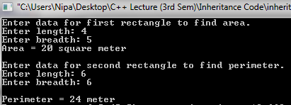
/* Perimeter class is derived from base class Rectangle. */
class Perimeter : public Rectangle
{
public:
float calc()
{
return 2*(length+breadth);
}
};
int main()
{
cout<<"Enter first rectangle to find area.\n";
Area a;
a.Set();
cout<<"Area = "<<a.calc()<<"square meter";
cout<<"Enter second rectangle to find perimeter";
Perimeter p;
p.Set()
cout<<"\nPerimeter = "<<p.calc()<<" meter";
return 0;
}

Slide 16
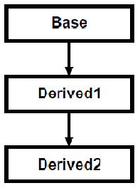
Multi Level Inheritance
when a derived class is created from another derived class, then that inheritance is called as multi level inheritance.
class A { .... ... .... }; class B : public A { .... ... .... }; class C : public B { .... ... .... };

Slide 17
Multi Level Inheritance Example
#include <iostream> using namespace std;
class A { public:
void display() { cout<<"Base class content."; } };
class B : public A { };
class C : public B { };
int main() { C c; c.display(); return 0; }

Slide 18
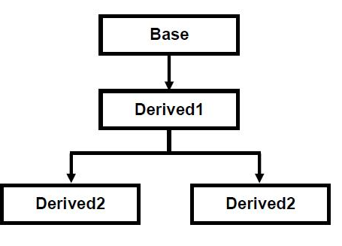
Hybrid Inheritance
Any combination of single, hierarchical and multi level inheritances is called as hybrid inheritance.

Slide 19
Hybrid Inheritance
#include<iostream>
using namespace std;
class A //Base class
{
public:
int l;
void len()
{
cout<<"\n\nLength :::\t";
cin>>l;
}
};
class B :public A
{
public:
int b,c;
void l_into_b()
{
len();
cout<<"\n\nBreadth :::\t";
cin>>b;
c=b*l;
}
};

Slide 20
class C
{
public:
int h;
void height()
{
cout<<"\n\nHeight :::\t";
cin>>h;
}
};
//Hybrid Inheritance Level
class D:public B,public C
{
public:
int res;
void result()
{
l_into_b();
height();
res=h*c;
cout<<"\n\nResult (l*b*h) :::\t"<<res<<endl;
}
};
int main()
{
D d1;
d1.result();
}

Slide 21
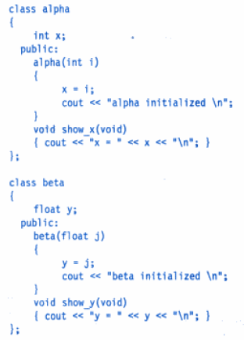
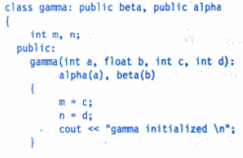
Constructors in Derived Class

Slide 22
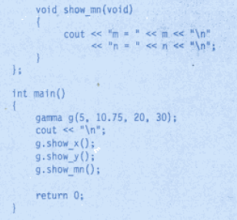
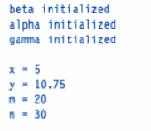
Constructors in Derived Class
Output

Slide 23
Virtual Base Class
An ambiguity can arise when several paths exist to a class from the same base class. This means that a child class could have duplicate sets of members inherited from a single base class. This is called the diamond shaped problem.
C++ solves this issue by introducing a virtual base class. When a class is made virtual, necessary care is taken so that the duplication is avoided regardless of the number of paths that exist to the child class.

Slide 24
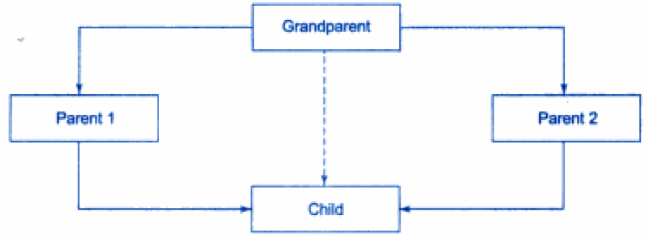
Virtual Base Class
Virtual Base Class

Slide 25

Virtual Base Class
#include<iostream>
using namespace std;
class A
{
public:
int i;
};
class B : virtual public A
{
public:
int j;
};
class C: virtual public A
{
public:
int k;
};
class D: public B, public C
{
public:
int sum;
};
int main()
{
D ob;
ob.i = 10; //unambiguous since only one copy of i is inherited.
ob.j = 20;
ob.k = 30;
ob.sum = ob.i + ob.j + ob.k;
cout << "Value of i is : "<< ob.i<<"\n";
cout << "Value of j is : "<< ob.j<<"\n";
cout << "Value of k is :"<< ob.k<<"\n";
cout << "Sum is : "<< ob.sum <<"\n";
return 0;
}

